Slide 1
Online Test Application
Phase 2 End Project

Slide 2
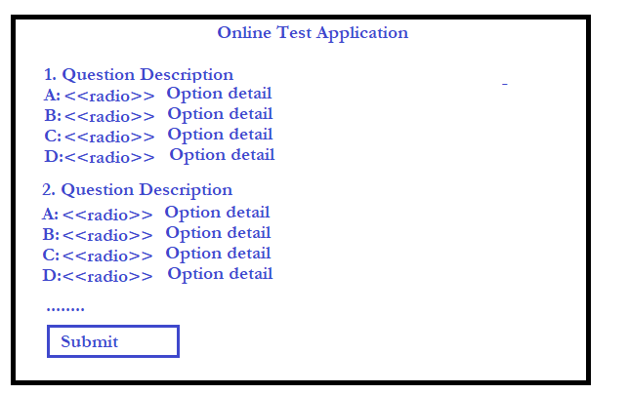
Project Output

Slide 3
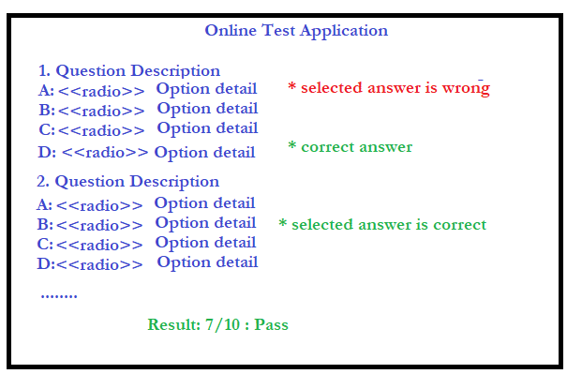
Project Output

Slide 4
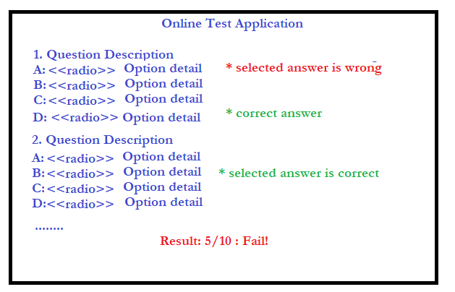
Project Output

